Slide 1
ETA Design Study
Jordan Camacho
Kim Christensen
June, 2016

Slide 2
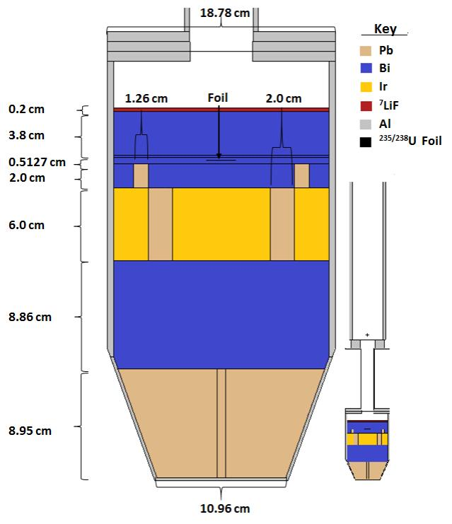
Initial Design of ETA

Slide 3
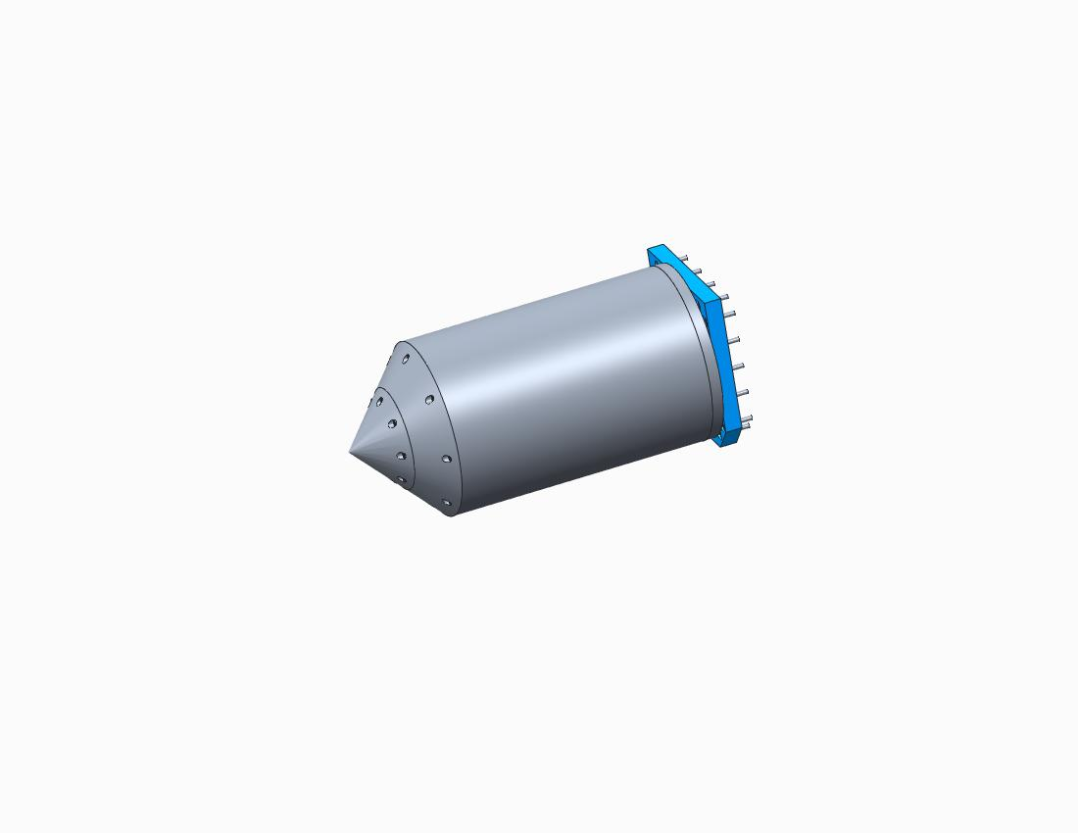
Isometric View of ETA

Slide 4
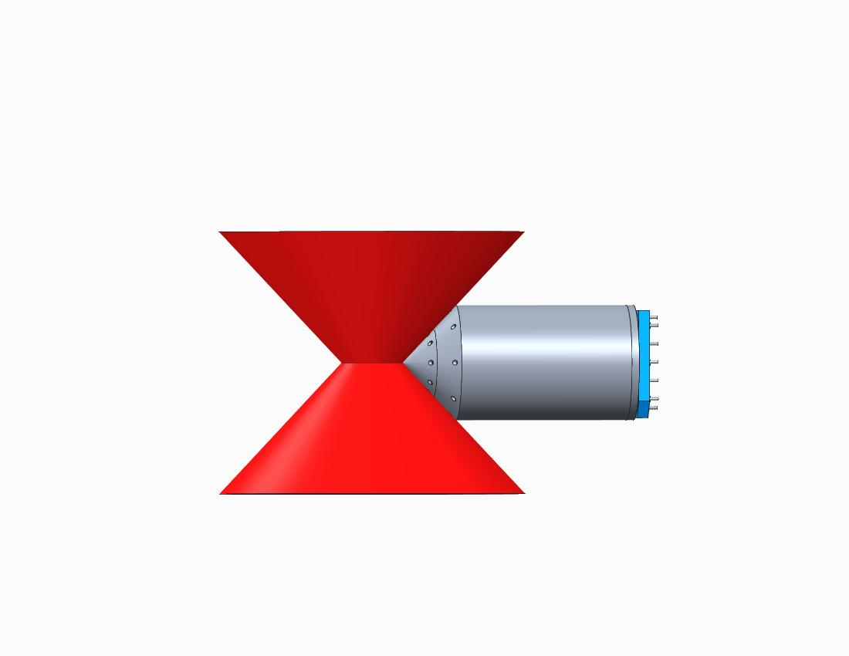

Side View of ETA
TCC

Slide 5
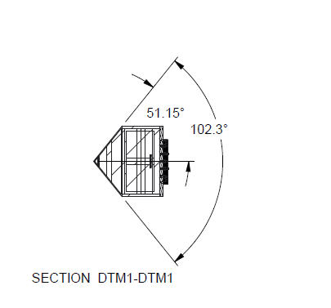
Cross-Section: Distance from TCC
Beginning of first layer (Pb)
TCC
110mm

Slide 6
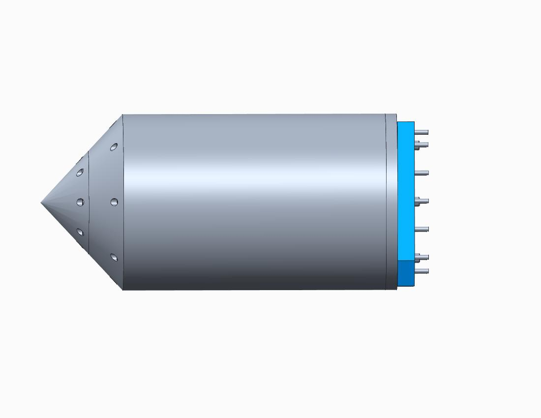
Cross Section: External Dimensions (Lengths)
Conical Component
Cylinder Cover Plate
Cylinder
Nose Cone
Mounting Bracket
51mm
36mm
280mm
12mm
18mm
379mm

Slide 7
Cross Section: Internal Dimensions (Widths/Diameters)
109.6mm
187.8mm

Slide 8
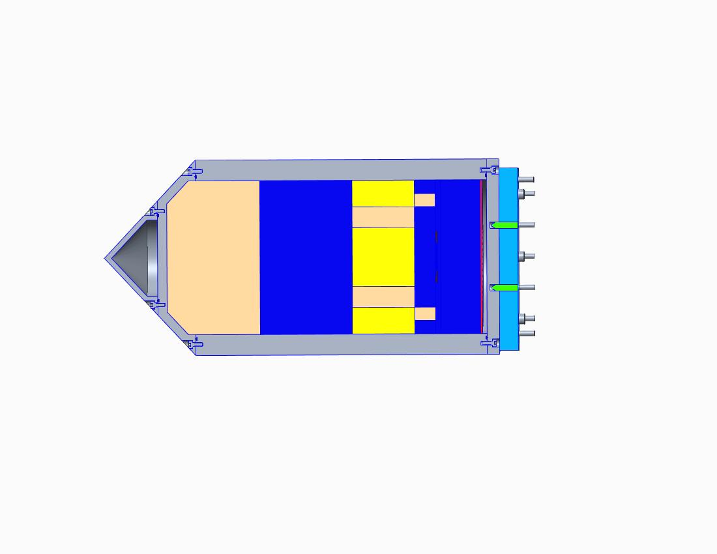
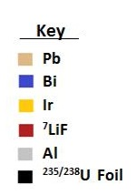
Cross Section: Internal Dimensions (Lengths)
88.6mm
20mm
38mm
HEU Toad
89.5mm
60mm
5.127mm
2mm

Slide 9


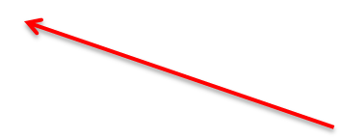
Cross Section: Internal Dimensions (Widths/Diameters)
Lead Rings
20mm
12.6mm
51.943mm
147.8mm
HEU Toad

